Slide 1
Classification, Reserve & RQO determination of water resources in the Mvoti to Umzimkulu Water Management Area
GROUNDWATER RESOURCE QUALITY OBJECTIVES
K. Sami
WSM Leshika Consulting Engineers
16 August 2015
PRESENTATION TITLE
Presented by:
Name Surname
Directorate
Date

Slide 2
Determining RQOs for Groundwater
Assessed groundwater using the previous Groundwater Reserve Investigation (SRK, 2014)
Detailed assessment of groundwater resources and contribution to baseflow – fully account for groundwater-surface interaction
Express groundwater use relative to resources and impacts on baseflow
Evaluate groundwater quality and Groundwater Quality Category
Express in terms of Present Class
Determine additional available groundwater resources with respect to the EWR low flow per catchment
Develop the RQOs

Slide 3
Process
Input data
Calculations and classification
Domestic use
Modelling
Model Outputs
Stress index
Caclulate present status
Irrigation use
Recharge
Impact on baseflow
Other uses
WRSM 2000 monthly model
Natural + present baseflow
Groundwater cycle
Climate data
Calibration vs
Recharge data
Gauging weirs
dams
Groundwater quality
Borehole yields
ALLOCATABLE GROUNDWATER
EWR
DEVELOP RQO

Slide 4
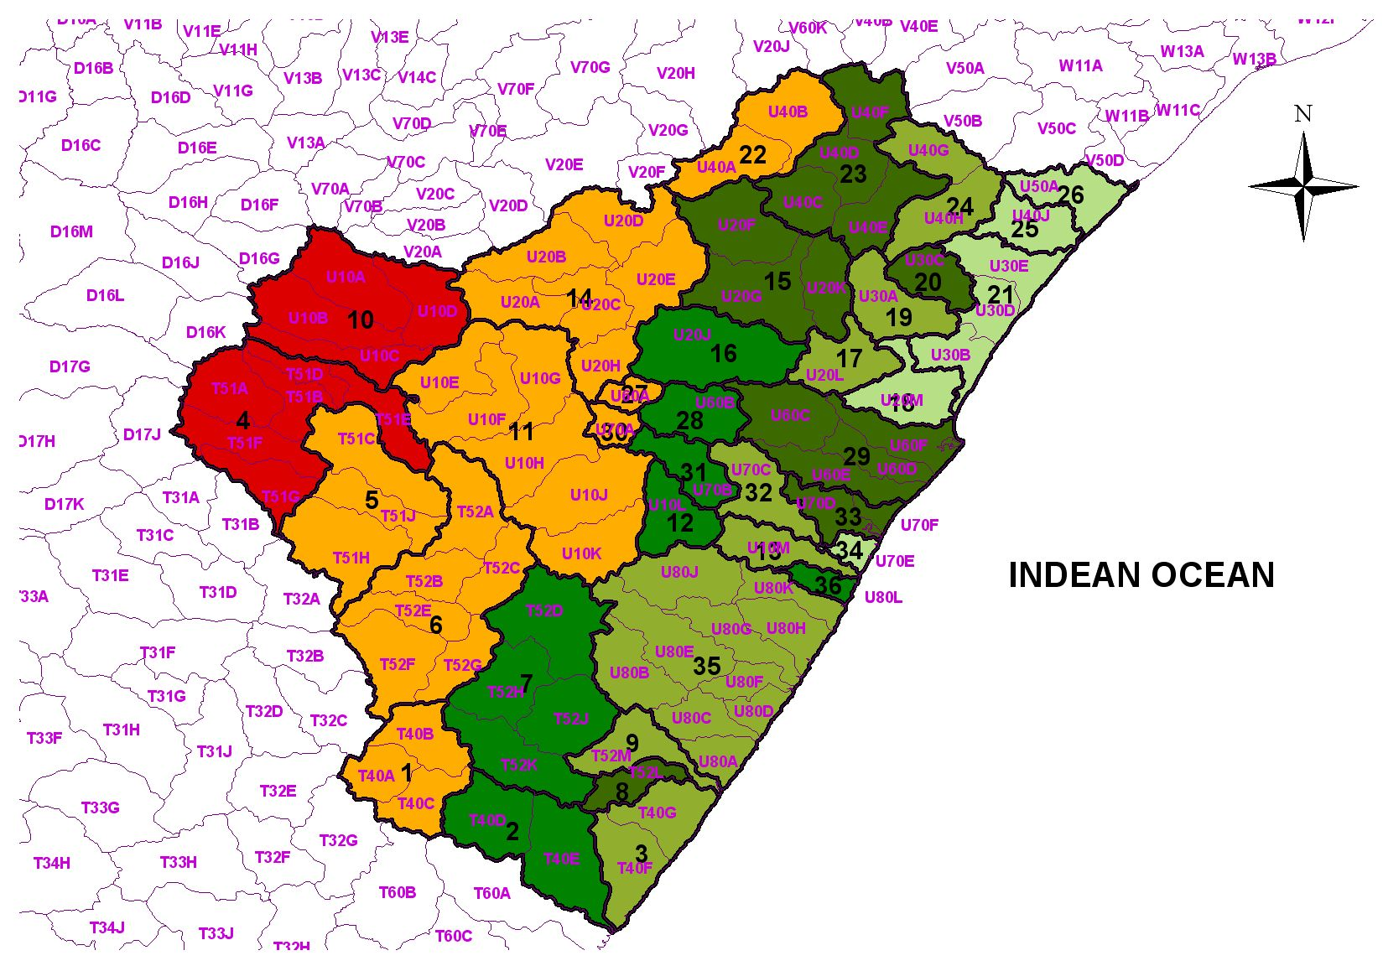
Study area IUAs
Grouped by:
Geology
Catchment
Topography

Slide 5
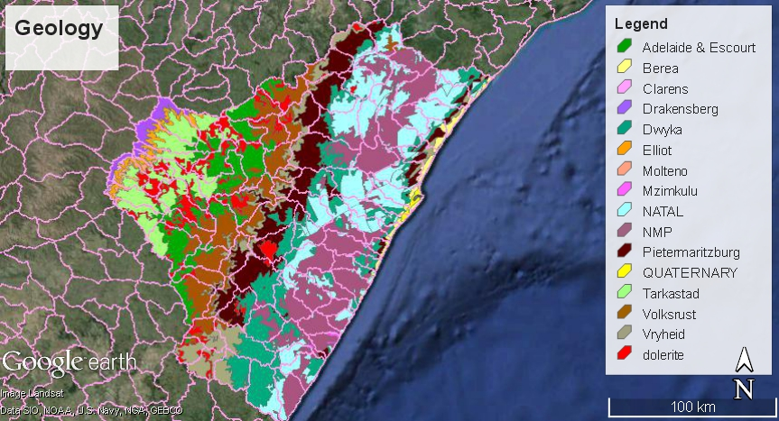
Study area Geology

Slide 6
Demand - Aquifer Recharge
How much groundwater is still available? Not much significant groundwater use
Class Use/ Aquifer recharge
F >95% Critically modified
E >65% Seriously modified
D >40% Largely modified
C >20% Moderately modified
B >5% Largely natural
A <5% Unmodified

Slide 7
Water Quality Category
Water Quality issues in the Natal Metamorphic Province, especially Fluoride
Water Quality Category
III
II
I
III <75% DWS Class 0-1
II >95% DWS Class 2, or >75% 0-1
I >95% DWS Class 0-1

Slide 8
Baseflow Reduction
Baseflow reduction due to Afforestation and sugar cane and AIPs significant in some areas
Baseflow reduction
F >95% Critically modified
E >65% Seriously modified
D >40% Largely modified
C >20% Moderately modified
B >5% Largely natural
A <5% Unmodified

Slide 9
Parameters for Setting RQOs
ParameRQOs
Baseflow
Water Quality
Harvest Potential vs groundwater use
Water Level

Slide 10
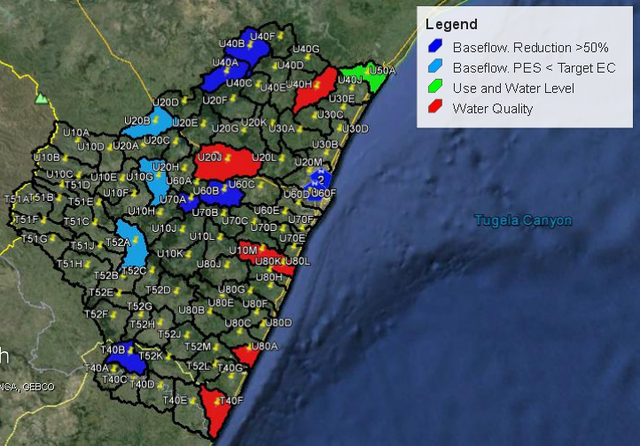
Priority Areas for Groundwater RQOs

Slide 11
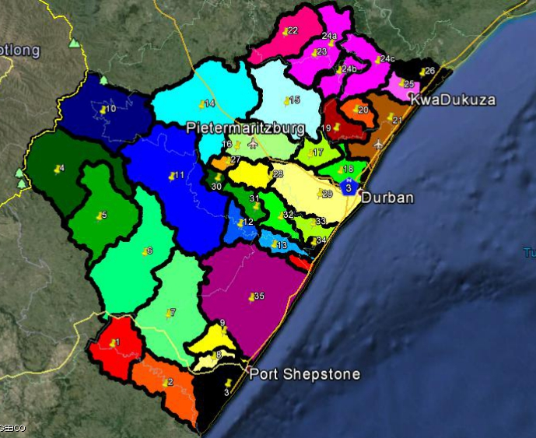
GROUNDWATER UTILISATION

